Slide 1


using docker Part 1: installation

Slide 2
What you will learn
Why Docker for Data Science?
Signing Up
Introduction to Docker
Docker Architecture
Installing Docker Desktop

Slide 3
Why docker for data science

Slide 4


Slide 5
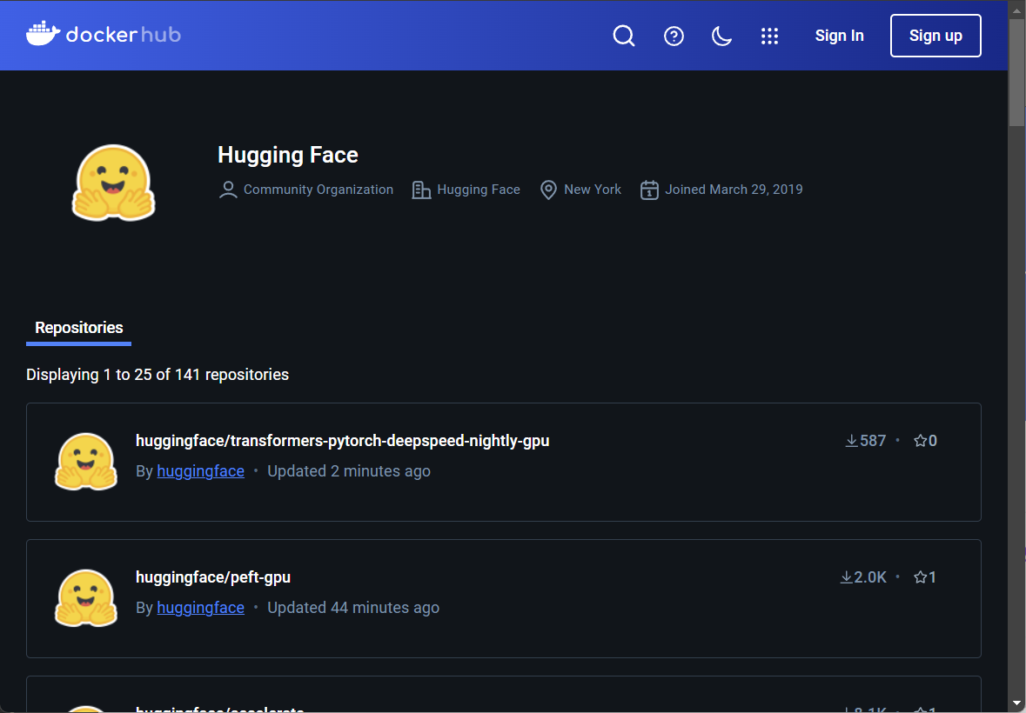
Notes:
https://hub.docker.com/u/huggingface

Slide 6
Signing Up

Slide 7
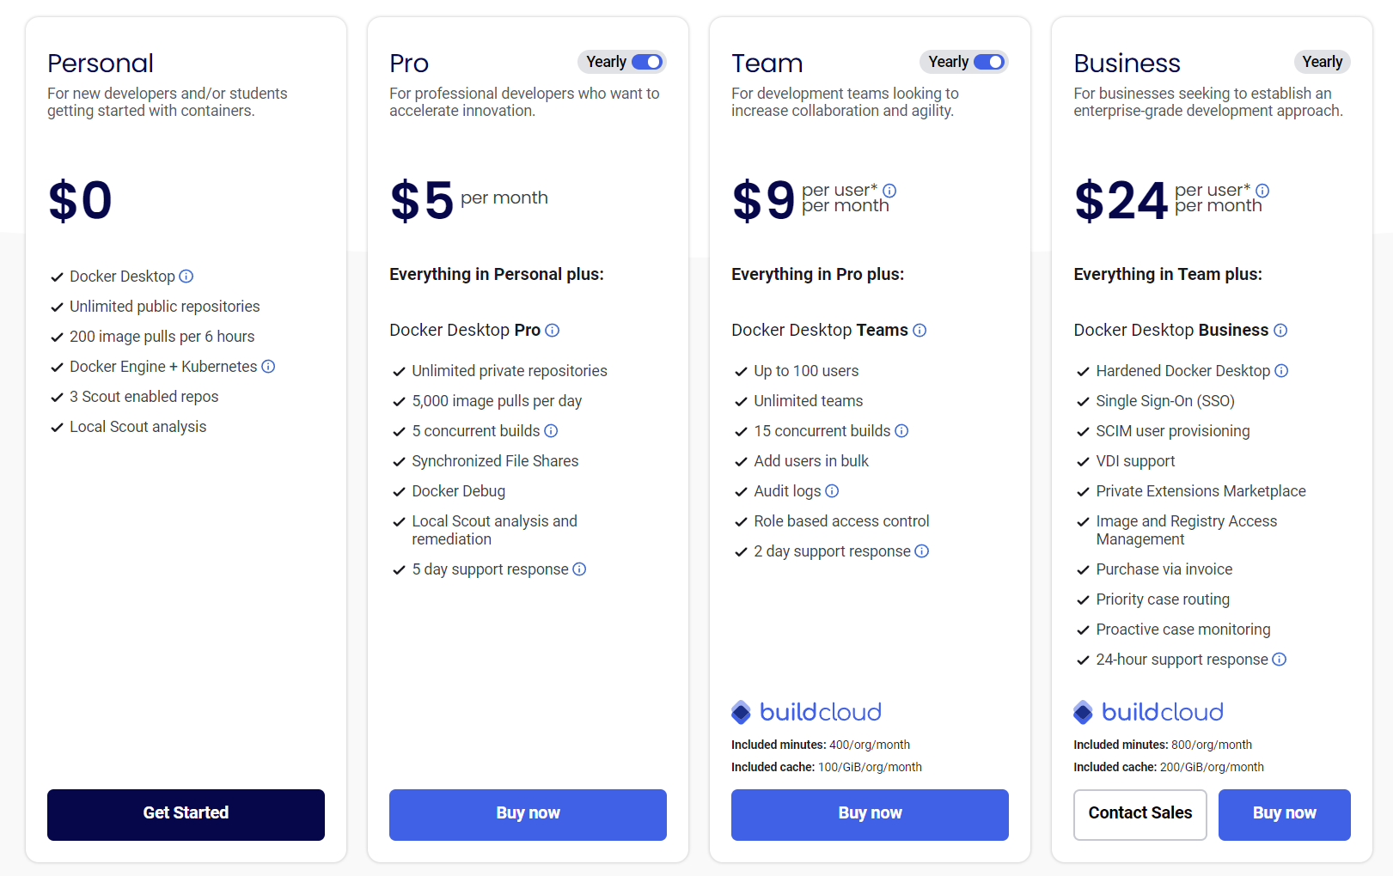
Notes:
https://www.docker.com/pricing/

Slide 8
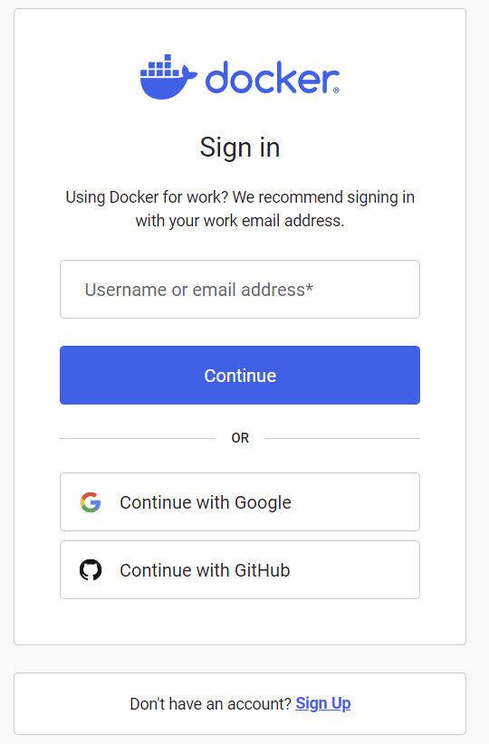

Slide 9
Introduction to docker

Slide 10
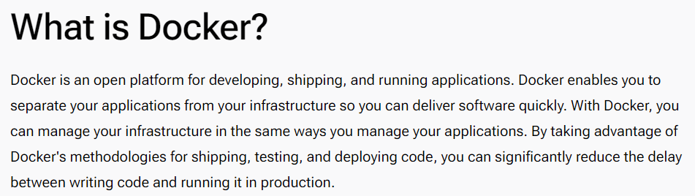
Notes:
https://docs.docker.com/get-started/docker-overview/

Slide 11
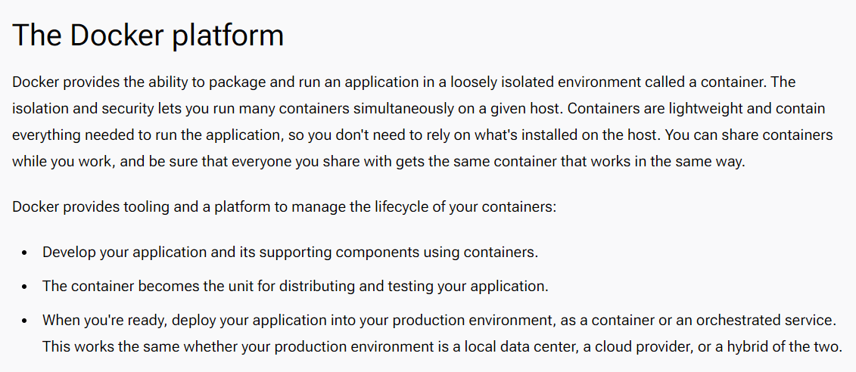

Slide 12
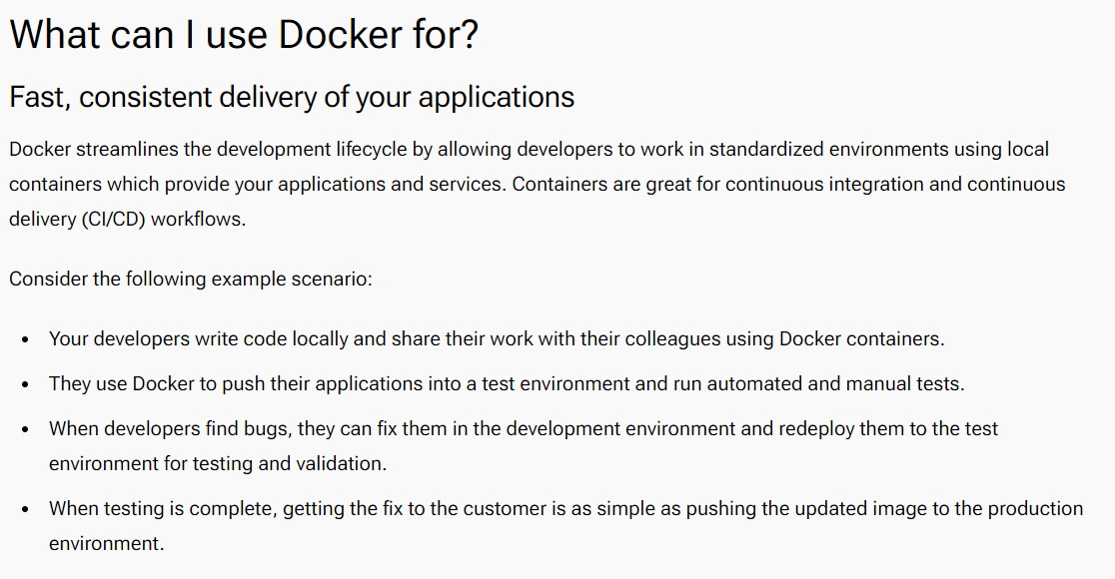
Notes:
https://docs.docker.com/get-started/docker-overview/

Slide 13
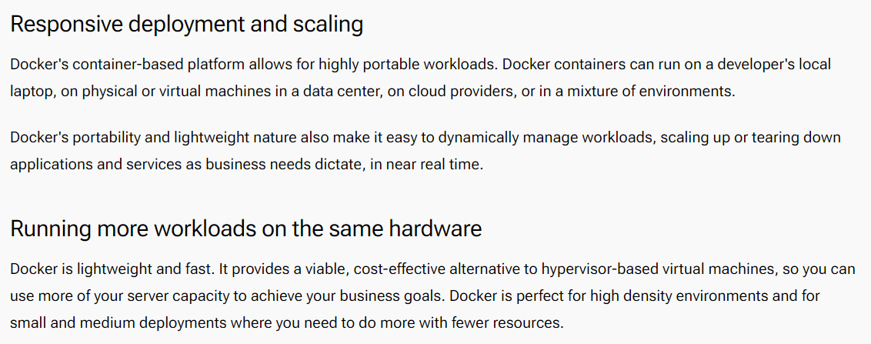

Slide 14
Docker Architecture

Slide 15
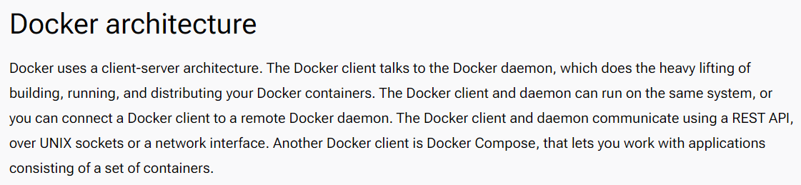

Slide 16
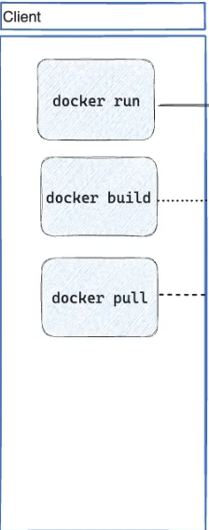
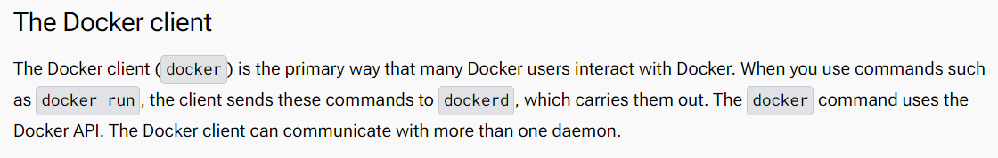

Slide 17
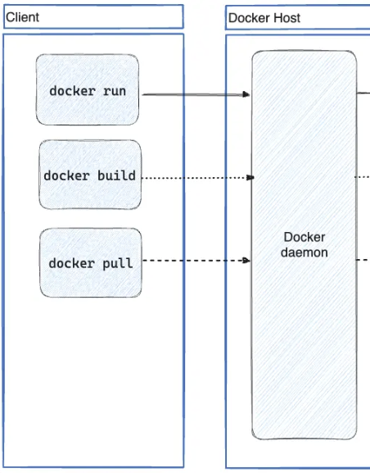
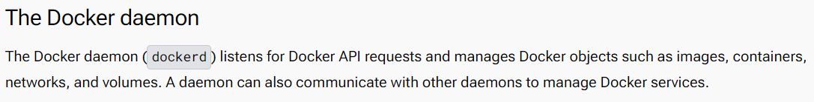

Slide 18
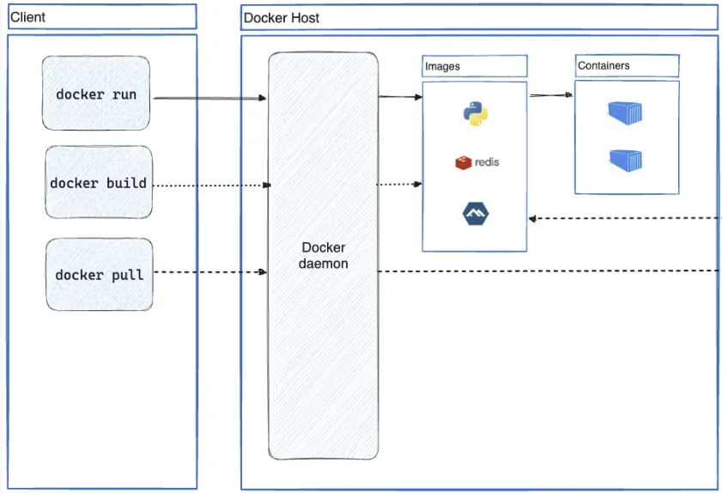

Slide 19
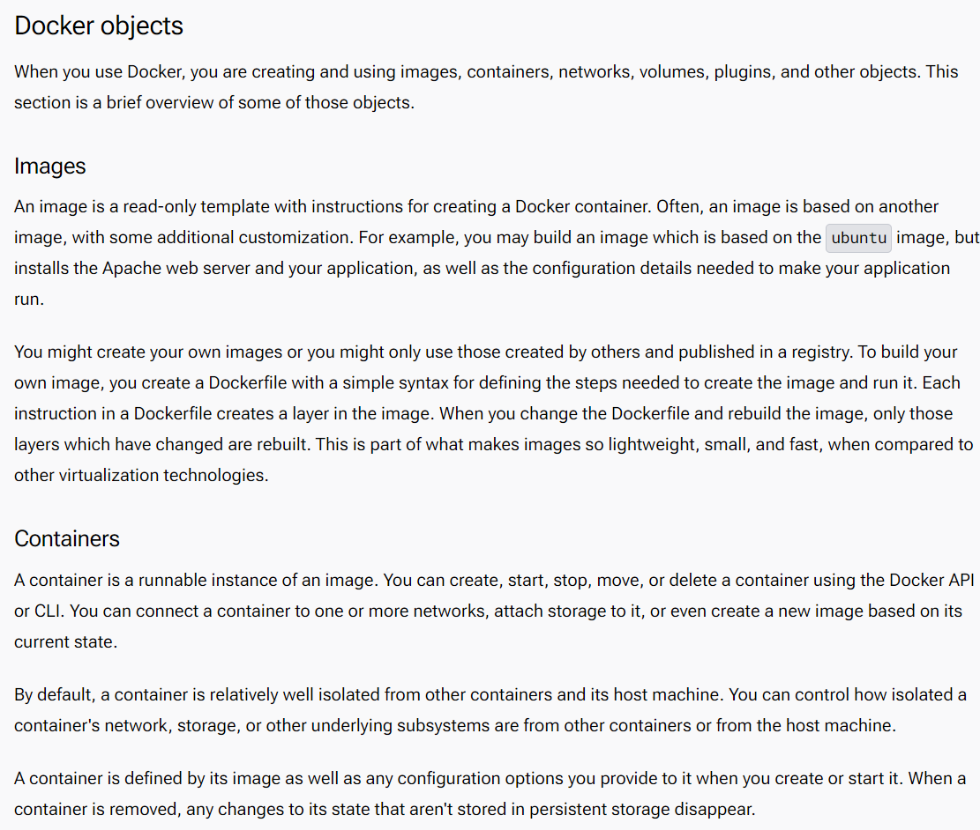
Notes:
https://docs.docker.com/get-started/docker-overview/

Slide 20
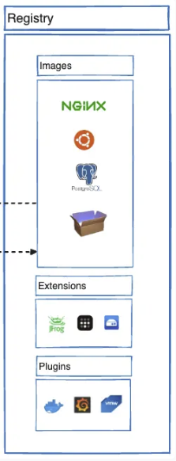
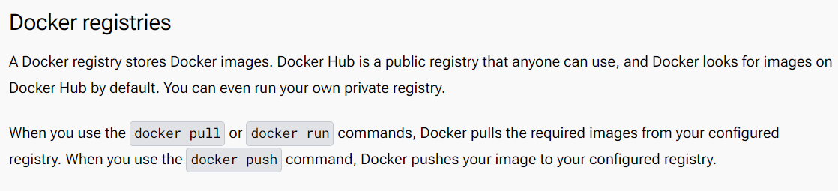

Slide 21
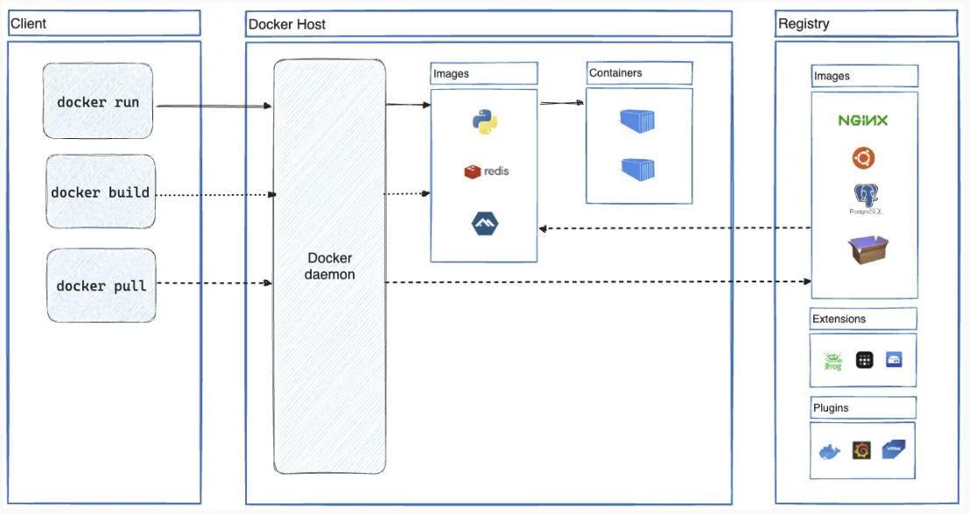

Slide 22
Installing docker desktop

Slide 23
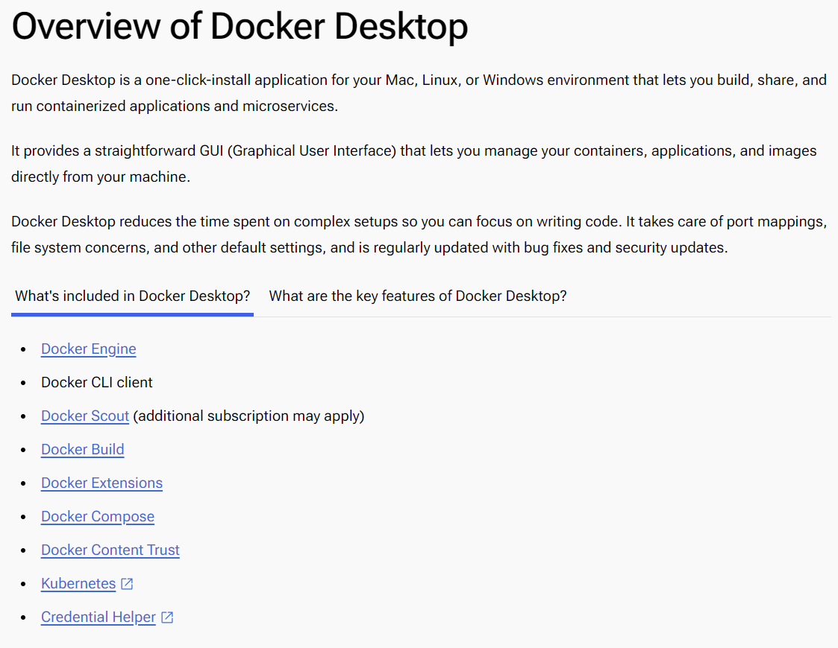
Notes:
https://docs.docker.com/desktop/

Slide 24
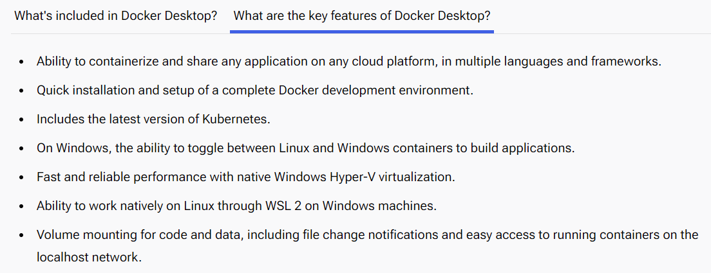
Notes:
https://docs.docker.com/desktop/

Slide 25
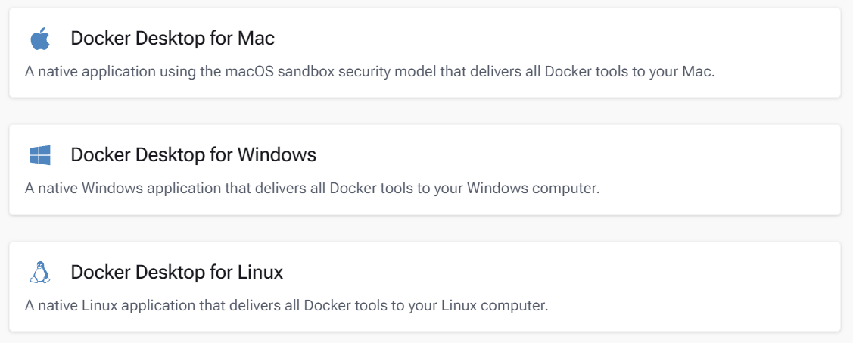
Notes:
https://docs.docker.com/get-started/get-docker/

Slide 26
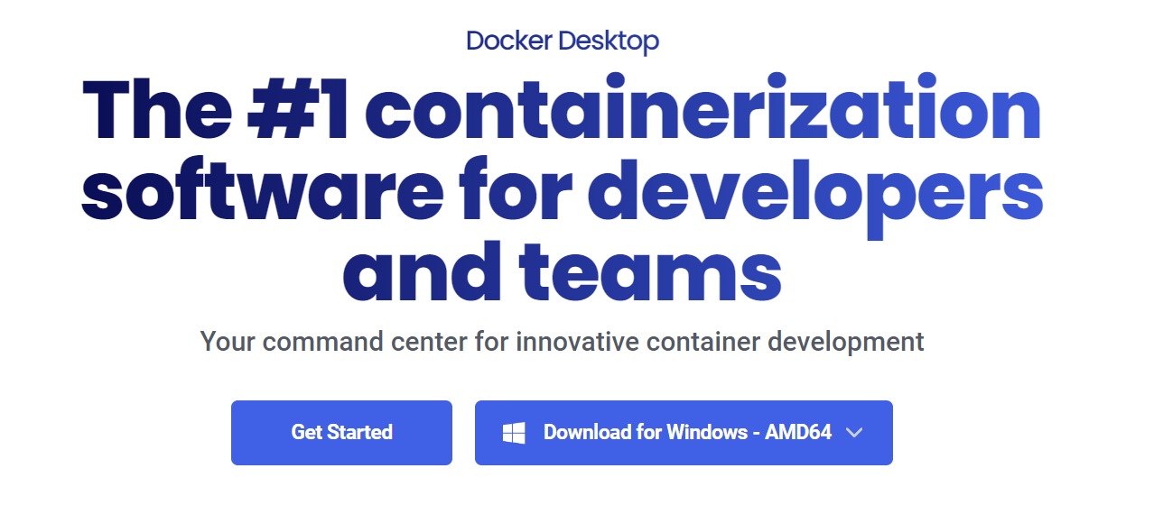
Notes:
https://www.docker.com/products/docker-desktop/

Slide 27
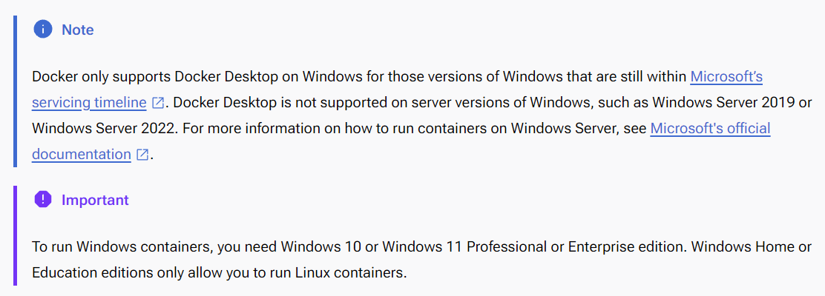
Notes:
https://docs.docker.com/desktop/install/windows-install/

Slide 28
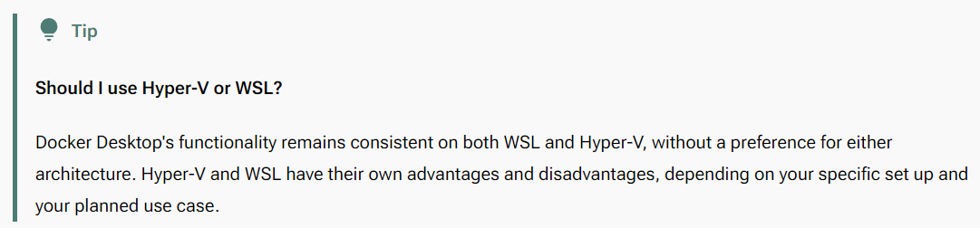
Notes:
https://docs.docker.com/desktop/install/windows-install/

Slide 29
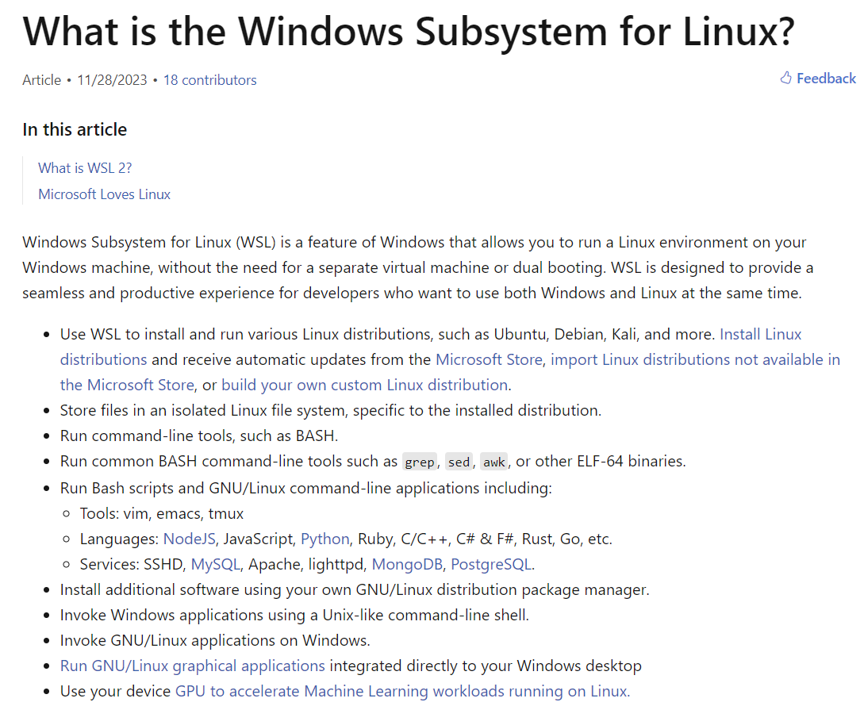
Notes:
https://learn.microsoft.com/en-us/windows/wsl/about

Slide 30
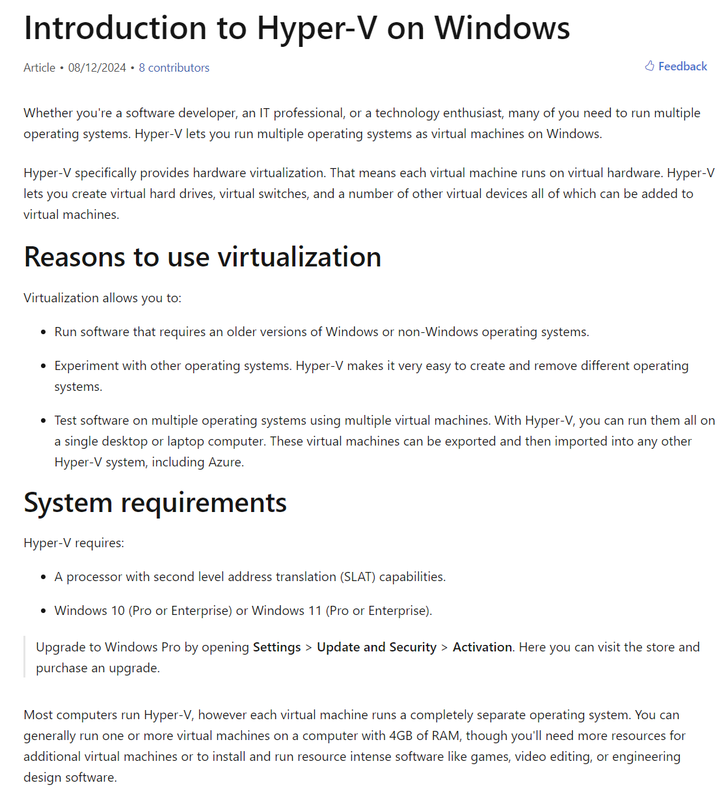
Notes:
https://learn.microsoft.com/en-us/virtualization/hyper-v-on-windows/about/

Slide 31
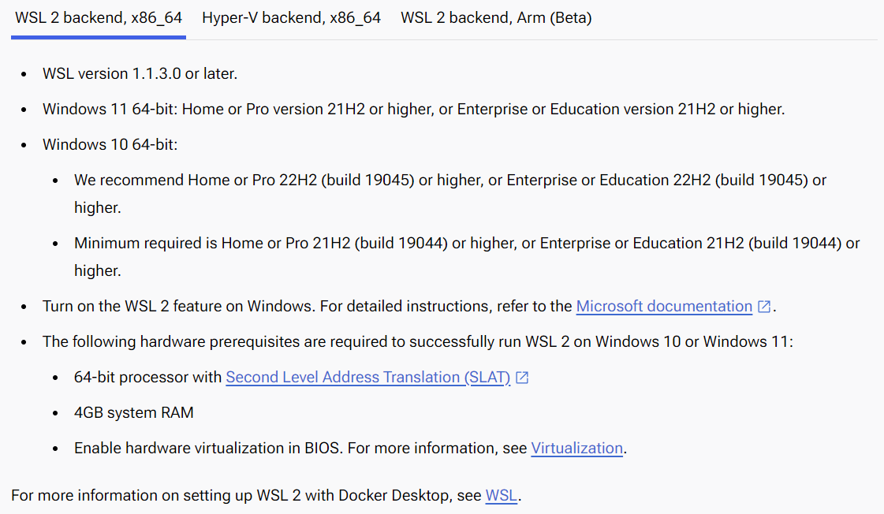

Slide 32
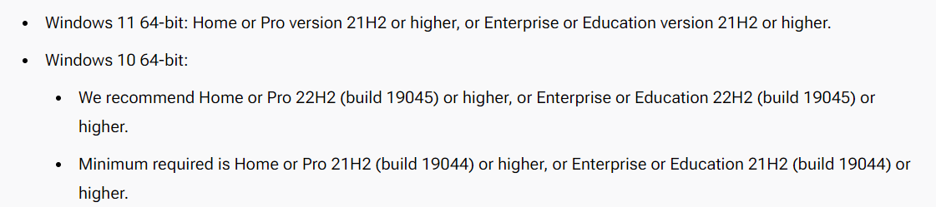
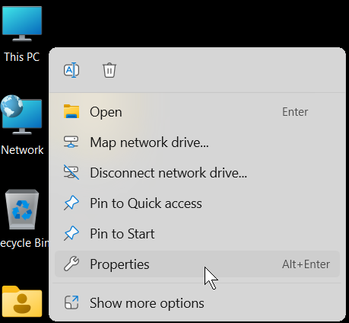

Slide 33
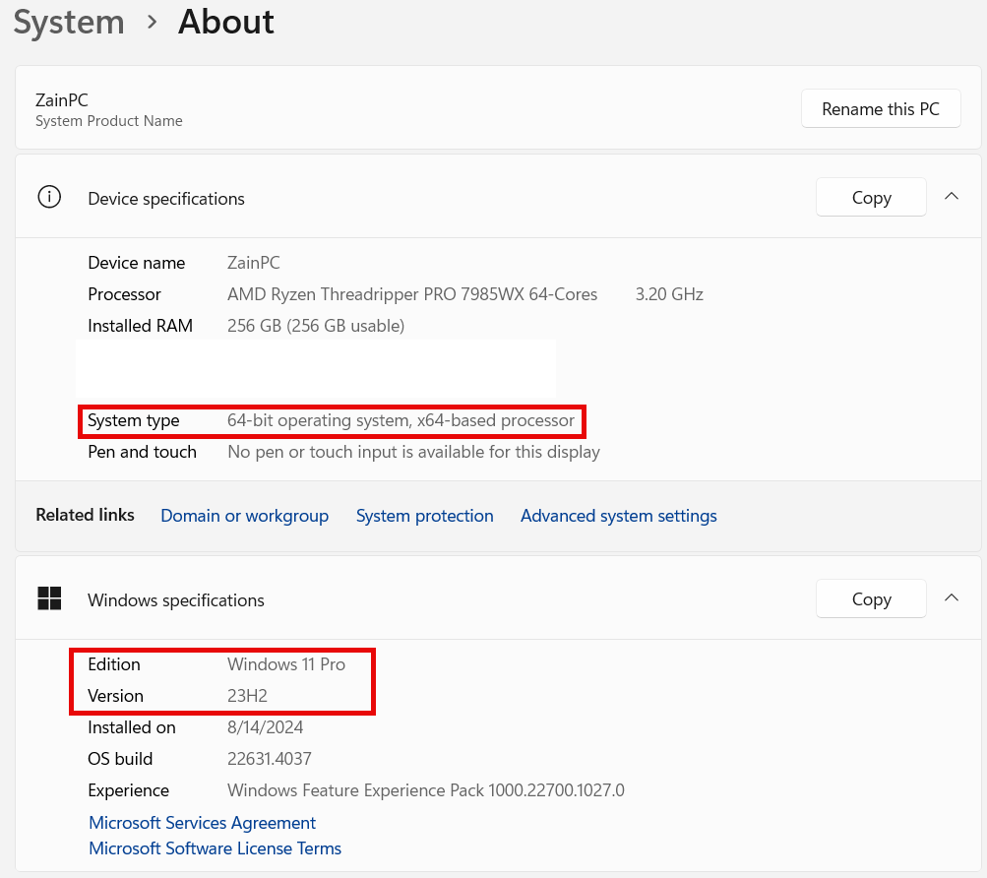

Slide 34
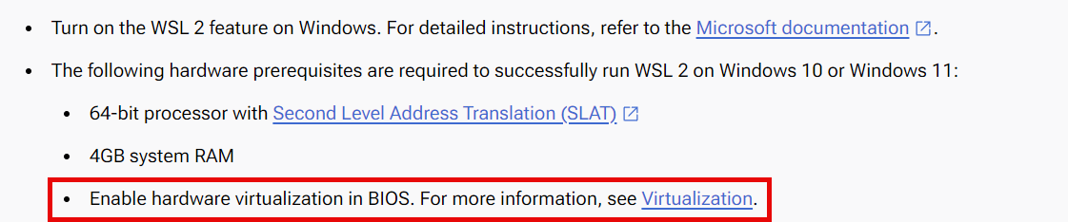
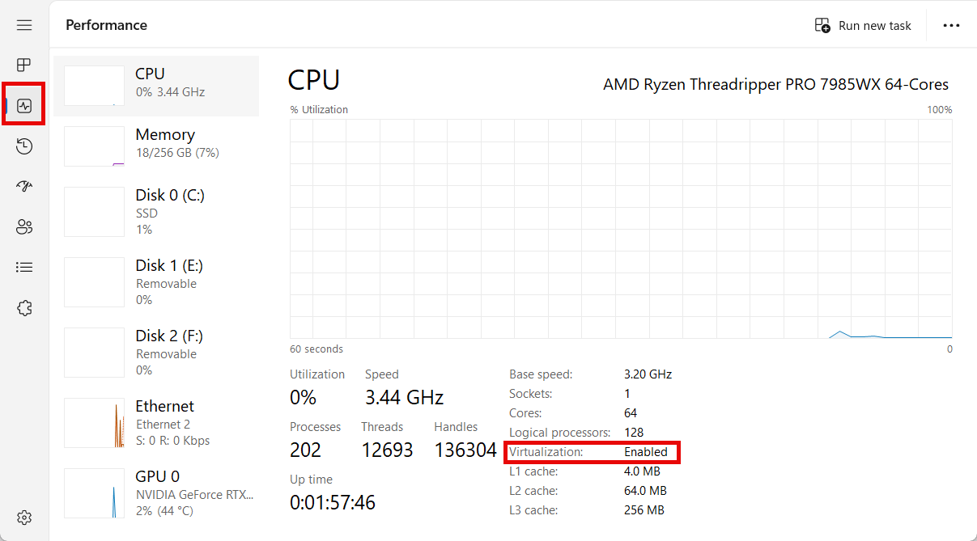
Notes:
https://docs.docker.com/desktop/troubleshoot/topics/#virtualization-must-be-turned-on

Slide 35
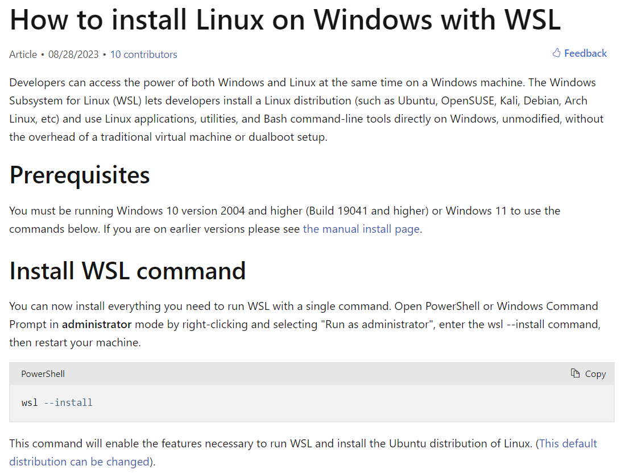
Notes:
https://learn.microsoft.com/en-us/windows/wsl/install

Slide 36
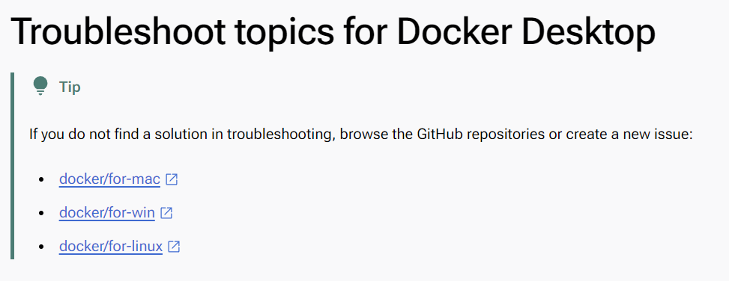
Notes:
https://docs.docker.com/desktop/troubleshoot/topics/

Slide 37
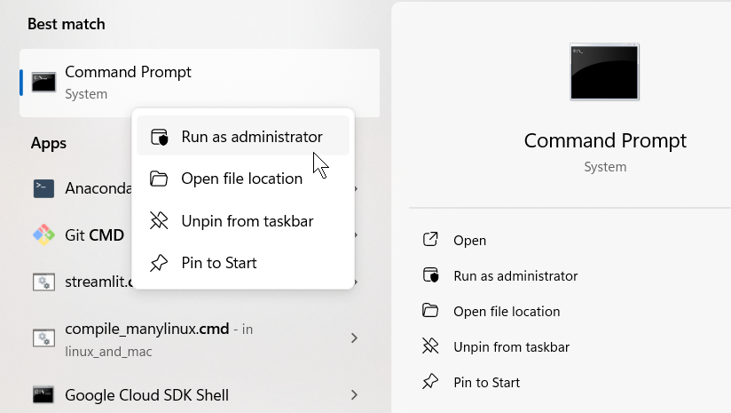
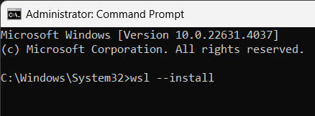
Demo: installing wsl
Notes:
(make sure you are running as administrator)
wsl --install

Slide 38
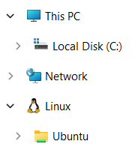
Success!

Slide 39
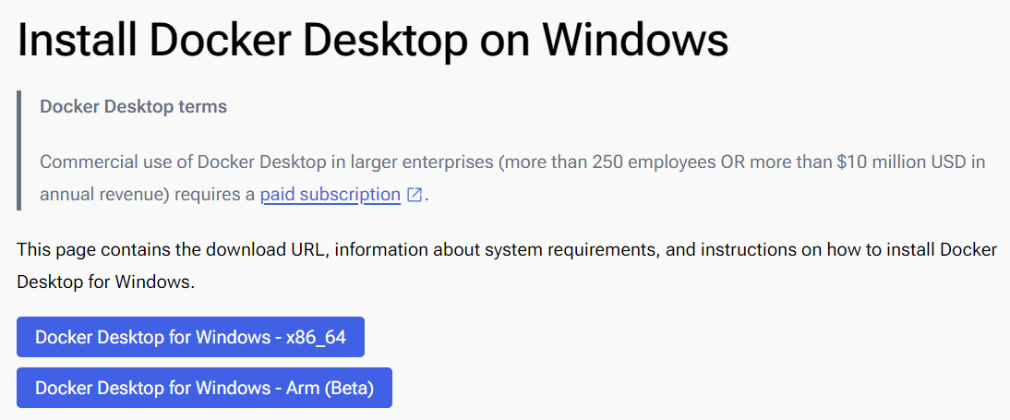
Demo: Installing docker desktop
Notes:
https://docs.docker.com/desktop/install/windows-install/

Slide 40


